Slide 1
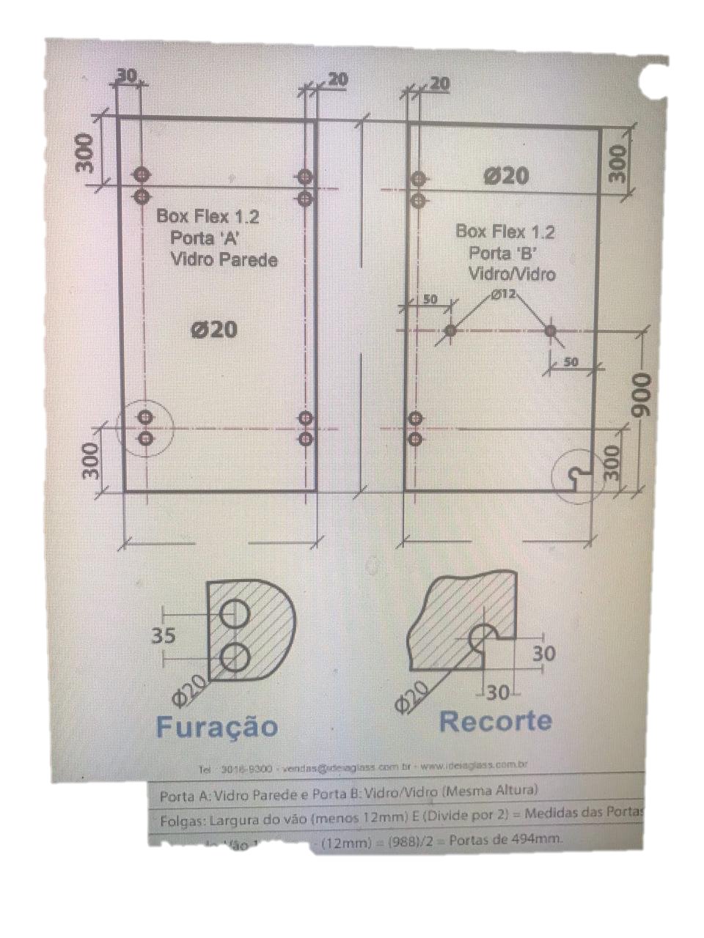
1900
1900
556
556

